Slide 1
Spam Filtering, Naïve Bayes

Slide 2

SPAM FILTERING

Slide 3
What is Spam Filtering?
Spam filters detect unsolicited, unwanted, and virus-infested email (called spam)
stop it from getting into email inboxes.
Internet Service Providers (ISPs) use spam filters to make sure they aren’t distributing spam.
Small- to medium- sized businesses (SMBs) also use spam filters to protect their employees and networks.

Slide 4
What is Spam Filtering?
Spam filters are applied to both inbound email (email entering the network) and outbound email (email leaving the network).
ISPs use both methods to protect their customers.
SMBs typically focus on inbound filters.
There are many spam filtering solutions available.
They can be hosted in the “cloud,” on computer servers, or integrated into email software such as Microsoft Outlook.

Slide 5
How do spam filters work?
Spam filters use “heuristics” methods
i.e. each email message is subjected to thousands of predefined rules (algorithms).
Each rule assigns a numerical score to the probability of the message being spam
if the score passes a certain threshold the email is flagged as spam
and blocked from going further.

Slide 6
How do spam filters work?
different types of spam filters are available for different criteria:
Content filters – parse the content of messages, scanning for words that are commonly used in spam emails.
Header filters – examine the email header source to look for suspicious information (such as spammer email addresses).
Blocklist filters – stop emails that come from a blocklist of suspicious IP addresses. Some filters go further and check the IP reputation of the IP address.
Rules-based filters – apply customized rules designed by the organization to exclude emails from specific senders, or emails containing specific words in their subject line or body.
No single method is a complete solution to the spam problem
there are always trade-offs between rejecting legitimate email vs. letting spam slip through.

Slide 7
Is spam filtering necessary?
In today’s world, spam filtering is a must to protect your business.
Spam is not going away.
It is estimated that 70 percent of all email sent globally is spam,
the volume of spam continues to grow because spam remains a lucrative business.
Spammers get ever more sophisticated and creative in their tactics to get their messages into your inboxes to create problems.
Spam filtering solutions must continually be updated to address this evolving threat.

Slide 8
Why is spam filtering important?
A spam filtering solution cannot be 100 percent effective.
However, a business email system without spam filtering is highly vulnerable.
It is important to stop as much spam as you can,
to protect your network from the many possible risks: viruses, phishing attacks, compromised web links and other malicious content.

Slide 9
Why is spam filtering important?
Spam filters also protect your servers from being overloaded with non-essential emails
the worse problem of being infected with spam software that may turn them into spam servers themselves.
By preventing spam email spam filters give an additional layer of protection to your users, your network, and your business.

Slide 10
Do you need a spam filter?
At the very least, spam email is a nuisance that will clog up your employees’ inboxes and overload your servers.
Spam is also dangerous — the entry point for serious attacks
that could damage your computers, your computer network, your bottom line, and even your company’s reputation.
Yes, you need a spam filter solution as the key first line of defense.

Slide 11
How can spam filters help you?
Spam filters are essential to protect your business.
When you decide to invest or upgrade your spam filter solution
There are countless spam filter programs out there
it will take time to figure out which one works best for your business.
.

Slide 12
How can spam filters help you?
Here are a few key things to look for:
At a minimum, the solution you choose must block spam.
-This might sound like a given, but not all spam filter software is up to the job
-(or doesn’t keep up to date with the evolving world of spam attacks).
The solution you choose must provide the security you need for your network,
-but not stop the legitimate emails your employees need to conduct their business.
Administrators must have the ability to edit and create rules
predefined rule settings so that the solution meets your organizational needs.
This customization should be easy, even for unsophisticated computer users.

Slide 13
Why Linear regression will not work for spam filtering?
Reason 1:
The first thing to consider is that your target is binary (0 if not spam,
1 if spam)
you wouldn’t get a 0 or a 1 using linear regression;
Linear regression is aimed at modeling a continuous output and this is binary.

Slide 14
Why Linear regression will not work for spam filtering?
Reason 2:
there are too many variables compared to observations
on the order of 10,000 emails with on the order of 100,000 words.
This won’t work.
Technically, the matrix in the equation is very huge to store

Slide 15
k-nn for spam filtering?
With 10,000 emails and 100,000 words, there is a problem,
Namely, the space needed for working has too many dimensions.
Yes, computing distances in a 100,000-dimensional space requires lots of computational work.
Real problem is:
Concept called “the curse of dimensionality,” makes k-NN a poor algorithm for spam filtering
As the nearest neighbours are too far away.

Slide 16
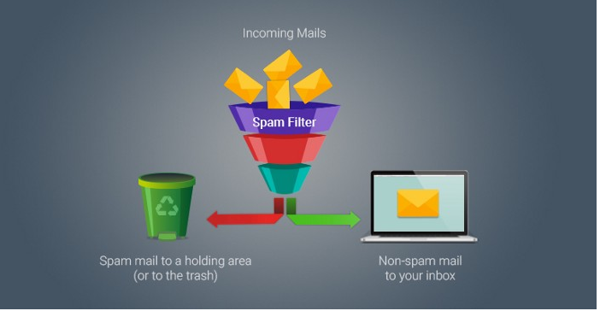
SPAM FILTERS

Slide 17
Naïve Bayes
One way spam emails are sorted is by using a Naive Bayes classifier.
The Naive Bayes algorithm relies on Bayes Rule.
This algorithm will classify each object by looking at all of it’s features individually.
Bayes Rule below shows us how to calculate the posterior probability for just one feature.

Slide 18
Naïve Bayes
The posterior probability of the object is calculated for each feature
then these probabilities are multiplied together to get a final probability.
This probability is calculated for the other class as well.
Which ever has the greater probability that ultimately determines what class the object is in.

Slide 19
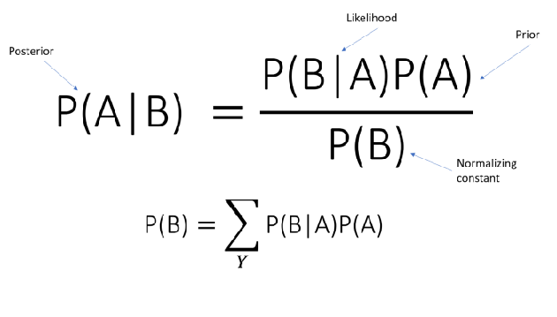
Naïve Bayes

Slide 20
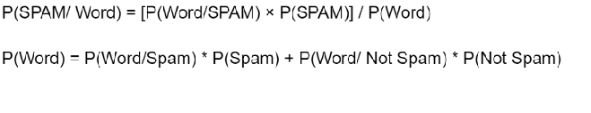
Naïve Bayes
For our purposes, the object is an email and the features are the unique words in the email.
Thus, there is a posterior probability calculated for each unique word in them email.
Plugging this into Bayes Rule, our formula will look something like this:

Slide 21
Naïve Bayes – case study

